Slide 1


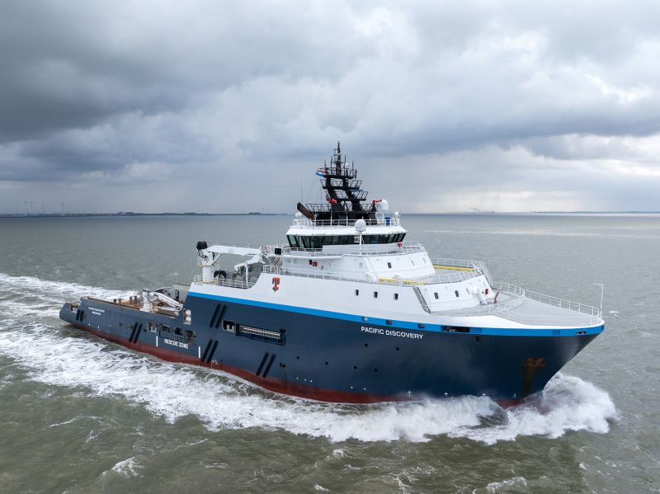
SSY Offshore
Spot Market Update
10 November 2025

Slide 2

PSV Weekly Report
Norway Spot Market Update
Rate Development Norwegian side
Last done | Average Last 5 Fixtures | Average Trend Going Forward
225,000 NOK | 160,000 NOK
Recent PSV Spot Fixtures Norwegian side
Date | Vessel | Charterer | Rate (NOK) | Scope of Work | Period | Commencement | Expected
06.11.2025 | EDDA FRAM | Equinor Energy AS | 225,000 | Supply duties | D/D 14 | 07.11.2025 | 11.11.2025
06.11.2025 | AURORA GALAXY | Equinor Energy AS | 225,000 | Supply duties | 4 days firm + D/D 17 | 06.11.2025 | 11.11.2025
04.11.2025 | STRIL MERMAID | Aker BP | RNR | Supply duties | D/D (Call off) | 05.11.2025 | 13.11.2025
03.11.2025 | EDDA FERD | Equinor Energy AS | 95,000 | Supply duties | D/D 21 | 04.11.2025 | 13.11.2025
03.11.2025 | NORTH POMOR | Equinor Energy AS | 95,000 | Supply duties | D/D 21 | 04.11.2025 | 13.11.2025
Open Spot Requirements
- None
PPT Vessels
Energy Duchess – PPT Bergen

Slide 3
PSV Weekly Report
Norway Spot Market Update
Norway PSV - Average Spot Rates
380,000
129,500
153,000
160,000
91,500
12 months prior
Norway PSV – No. Spot Fixtures
12 months prior
8
5

Slide 4
PSV Weekly Report
UK Spot Market Update
Rate Development UK side
Last done | Average Last Fixtures | Average Trend Going Forward
RNR | 4,700 GBP
Recent Spot PSV Fixtures UK side
Date | Vessel | Charterer | Rate (GBP) | Scope of Work | Period | Commencement | Expected
07.11.2025 | SPIRIT OF EMDEN | Ineos FPS | RNR | Supply duties | D/D 14 | 06.11.2025 | 09.11.2025
07.11.2025 | FS AQUARIUS | Anasuria | 4,500 | Supply duties | C/R + C/R opt | 07.11.2025 | 14.11.2025
06.11.2025 | SYMPHONY TIDE | CNR International UK Ltd | 5,000 | Supply duties | D/D 14 | 08.11.2025 | 24.11.2025
05.11.2025 | TRIUMPH TIDE | Peterson Den Helder B.V. | RNR | Supply duties | D/D 21 | 05.11.2025 | 20.11.2025
05.11.2025 | ENERGY PARTNER | CNR International UK LTD | 4,250 | Supply duties | D/D 14 | 05.11.2025 | 09.11.2025
03.11.2025 | SERVICE TIDE | Shell UK | 5,000 | Supply duties | D/D 14 | 03.11.2025 | 13.11.2025
Open Spot Requirements
Ithaca: 21 days firm + D/D 14 from 15/11
Ithaca: 28 days firm + opt from 19-21/11
PPT Vessels
Highland Chieftain – PPT Aberdeen
Spirit Of Emden – PPT Aberdeen
Ace Discoverer – PPT Aberdeen
Ace Crathes – PPT Aberdeen
Energy Partner – PPT Aberdeen
Energy Empress – PPT Aberdeen
Energy Pace – PPT Aberdeen Next Charterer: Peterson Den Helder – 01/01

Slide 5
PSV Weekly Report
UK Spot Market Update
UK PSV - Average Spot Rates
6,650
7,300
4,100
4,600
4,850
12 months prior
UK PSV – No. Spot Fixtures
37
35
31
12 months prior

Slide 6
AHTS Weekly Report
Norway Spot Market Update
Rate Development Norwegian side
Last done | Average Last 5 Fixtures | Average Trend Going Forward
RNR | 950,000 NOK
Recent AHTS Spot Fixtures Norwegian side
Date | Vessel | Charterer | Rate (NOK) | Scope of Work | Period | Commencement | Expected
02.11.2025 | NORMAND DROTT | Aker BP | RNR | All duties | D/D 14 | 03.11.2025 | 19.11.2025
02.11.2025 | NORMAND PROSPER | Aker BP | RNR | All duties | D/D 14 | 03.11.2025 | 12.11.2025
31.10.2025 | ISLAND VALIANT | Aker BP | RNR | All duties (+WROV) | D/D (Call off) | 31.10.2025 | 20.11.2025
31.10.2025 | AURORA SANDEFJORD | Well Expertise | 900,000 | Prelay Deepsea Yantai | 2 days firm + D/D 12 | 01.11.2025 | 09.11.2025
20.10.2025 | SEA1 RUBY | Equinor Energy AS | 1,000,000 | Hook-up TO Encourage | 3 days firm + D/D 11 | 20.10.2025 | 26.10.2025
Open Spot Requirements
- None
PPT Vessels
Aurora Sandefjord – PPT Bergen
Sea1 Ruby – PPT Bergen
Odin Viking – PPT Bergen

Slide 7
AHTS Weekly Report
Norway Spot Market Update
Norway AHTS - Average Spot Rates
960,000
571,500
500,000
217,000
12 months prior
145,000
Norway AHTS – No. Spot Fixtures
17
12 months prior
2

Slide 8
AHTS Weekly Report
UK Spot Market Update
Rate Development UK Side
Last done | Average Last 5 Fixtures | Average Trend Going Forward
65,000 GBP | 54,200 GBP
Recent Spot AHTS Fixtures UK Side
Date | Vessel | Charterer | Rate (GBP) | Scope of Work | Period | Commencement | Expected
06.11.2025 | SIEM CHALLENGER | OMC | 65,000 | R/M Prospector 1 | D/D 14 | 06.11.2025 | 09.11.2025
05.11.2025 | MAGNE VIKING | OMC | 80,000 | R/M Valaris 248 | D/D 14 | 05.11.2025 | 13.11.2025
05.11.2025 | PACIFIC DISCOVERY | OMC | 55,000 | R/M Valaris 248 | D/D 14 | 05.11.2025 | 13.11.2025
03.11.2025 | SKANDI LOGGER | Noble Drilling | 40,000 | R/M Noble Resilient | D/D 14 | 06.11.2025 | 12.11.2025
03.11.2025 | BB OCTOPUS | Dana Petroleum | 40,000 | Heading Control | 7 days firm + D/D 14 | 03.11.2025 | 13.11.2025
03.11.2025 | SKANDI HANDLER | OMC | 45,000 | R/M Swift 10 | D/D 14 | 03.11.2025 | 19.11.2025
Open Spot Requirements
OMC – R/M Obana, D/D 14 from 11-12/11
PPT Vessels
Siem Challenger – PPT Montrose
Loke Viking – PPT Montrose
Njord Viking – PPT Montrose
Brage Viking – PPT Montrose

Slide 9
AHTS Weekly Report
UK Spot Market Update
UK AHTS - Average Spot Rates
52,650
51,600
33,500
12 months prior
14,850
15,100
UK AHTS – No. Spot Fixtures
18
16
14
12 months prior

Slide 10
Contact us
Henrik Kuosmanen
Offshore Broker
Email: h.kuosmanen@ssyglobal.com
Tel: +47 944 82 312
Johan Gustafsson
Offshore Analyst
Email: j.gustafsson@ssyglobal.com
Tel: +47 916 31 912
Madeleine Røstad
Offshore Broker
Email: m.rostad@ssyglobal.com
Tel: +47 913 45 011
Disclaimer
While every care has been taken to ensure that the information in this presentation is accurate, SSY can accept no responsibility for any errors or omissions or any consequences arising therefrom. Figures are based on the latest available information, which is subject to subsequent revision and correction. The views expressed are those of SSY Consultancy and Research Ltd and do not necessarily reflect the views of any other associated company. Reproducing any material from this presentation without permission from SSY is strictly prohibited.
Further information on our terms and conditions can be found at: https://www.ssyglobal.com/legal/client-terms-and-conditions

Slide 11


www.ssyglobal.com

